Slide 1
G 0402 NIMS Overview for Senior Officials
G 0402 NIMS Overview for Senior Officials (Executives, Elected, and Appointed)

Slide 2
Unit 1: Course Introduction
Unit 1:
Course Introduction

Slide 3
Unit Objectives
Terminal Learning Objective:
Explain the course goals and objectives.
Enabling Learning Objectives:
Describe the course goals.
Describe the course objectives.

Slide 4
Introductions
Please share your:
Name.
Job title and jurisdiction.
Course expectations

Slide 5
Course Objective
Upon completion of this course, students will be able to explain National Incident Management System (NIMS) tenets and the role of the four command and coordination entities (ICS, EOC, MAC Group and JIS) within NIMS.

Slide 6
Course Terminal Objectives
Explain the National Incident Management System. (Unit 2)
Explain the NIMS Management Characteristics, the organizational structure of the Incident Command System, and the role of the Command and General Staff. (Unit 3)
Explain the attributes and purpose of Emergency Operations Centers. (Unit 4)
Explain the interconnectivity between the MAC Group, EOCs, the Joint Information System, and Incident Command. (Unit 5)
Explain the Senior Official’s role in preparedness. (Unit 6)

Slide 7
Course Overview
Unit 1: Course Introduction
Unit 2: What is NIMS?
Unit 3: ICS Organization and Features
Unit 4: NIMS Coordination: Emergency Operations Centers
Unit 5: NIMS Coordination: The MAC Group and the Joint Information System
Unit 6: Preparedness
Unit 7: Course Summary

Slide 8
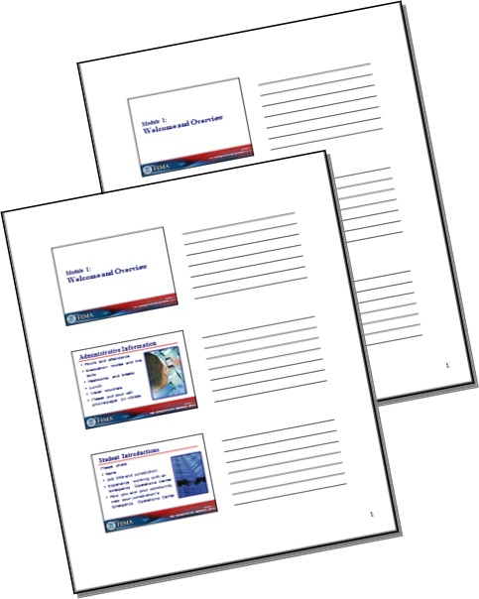
Student Course Materials
Student Manual contains:
Printed unit visuals and associated information
Handouts
Resources for Senior Officials document
Sample local Delegation of Authority letter

Slide 9
Objectives Review
What are the course goals and objectives?

